Slide 1



Chinook Sales Analysis
Hrishik Verma

Slide 2
Problem Statement
‘ You are hired as a data analyst at Chinook, and your objective is to analyze music record sales data to gain insights and make recommendations for the company's strategy in the physical music market. ’

Slide 3
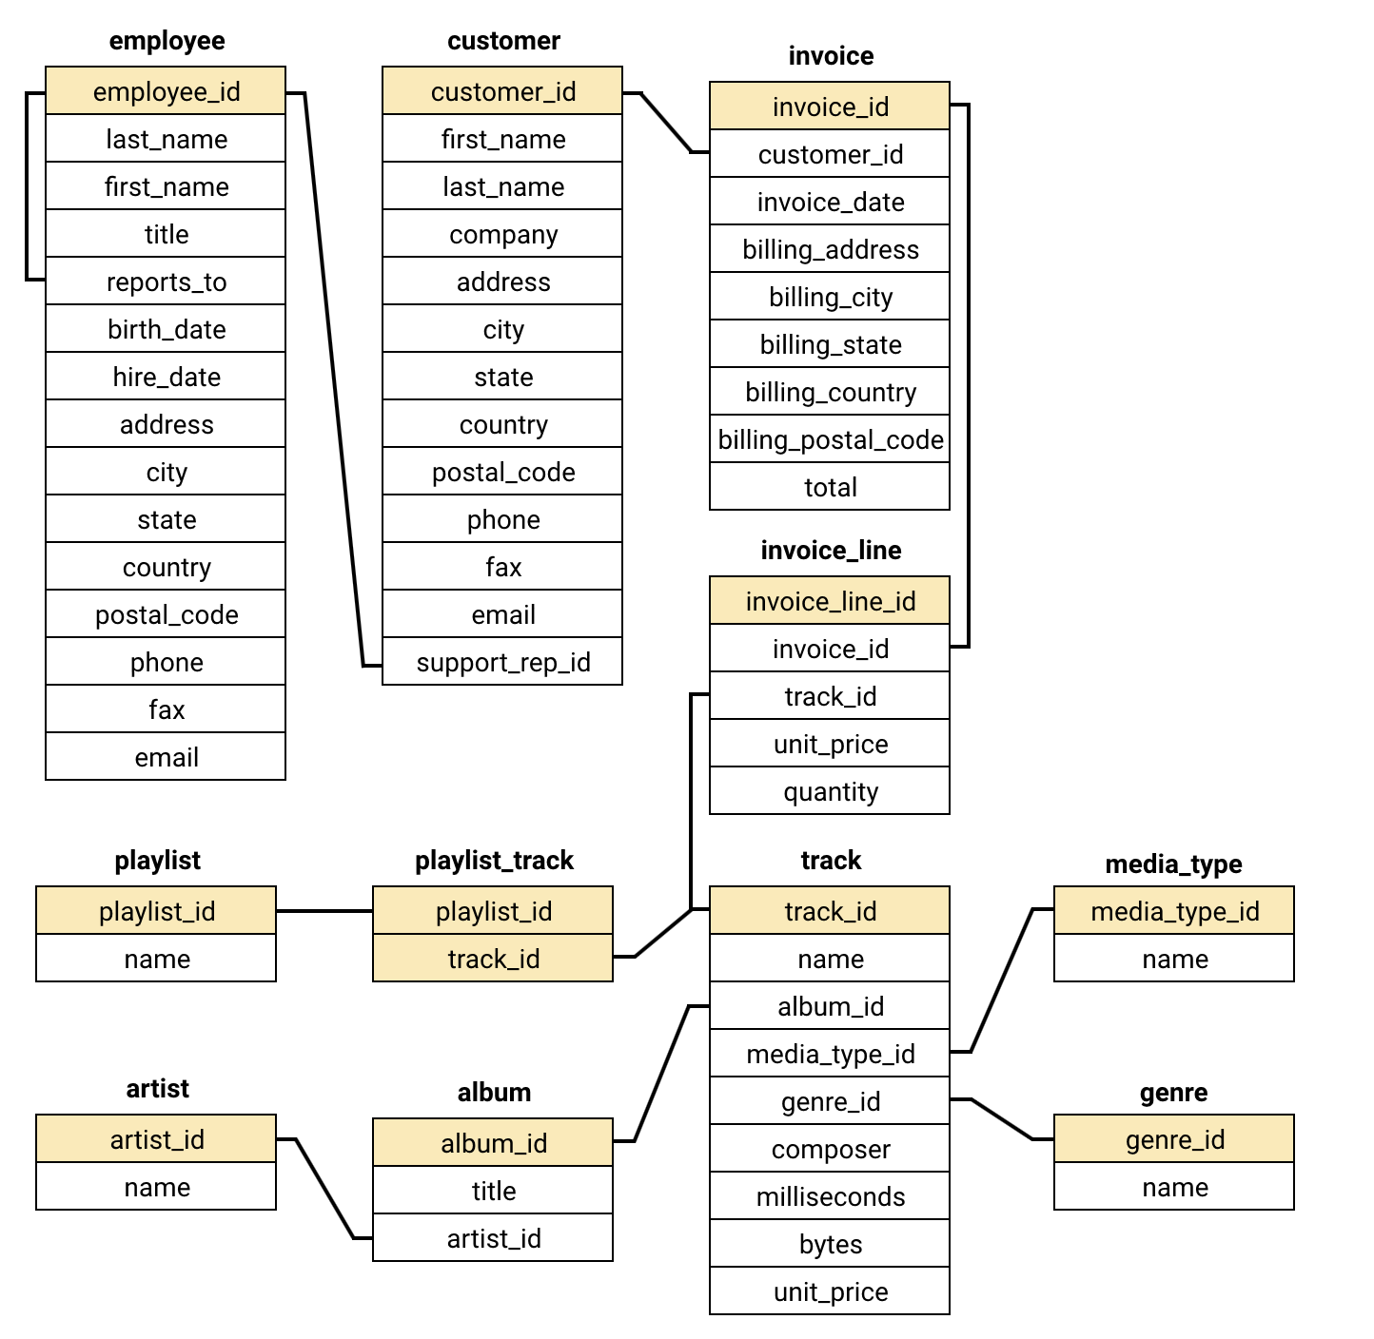
Overview of the Database
No. of Tables: 11
347 Rows in Table ‘album’
275 Rows in Table ‘artist’
25 Rows in Table ‘genre’
3483 Rows in Table ‘track’
Customers from 24 Countries

Slide 4
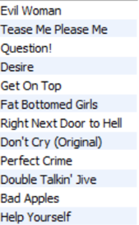
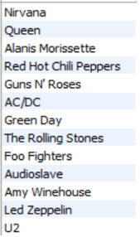
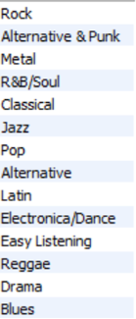
Objective Questions
TOP SELLING TRACKS, ARTISTS AND GENRES IN THE USA

Slide 5
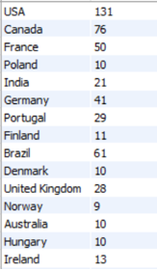
Objective Questions
Demographic Breakdown Of Customers, By Country
Thus, we find that the Anglosphere and European nations make up the bulk of Chinook’s customer demographic, with exceptions from Asia (India) and Latin America (Brazil).

Slide 6
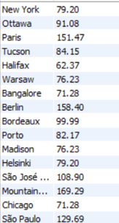
Objective Questions
Total Revenue By City
As expected, capitals and major cities prove to be the most lucrative centers. India’s Bangalore is a notable outlier for being the only Asian and Indian entry, as well as a non-capital.

Slide 7
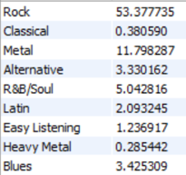
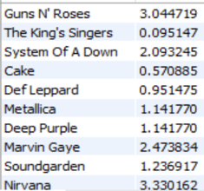
Objective Questions
% Of Total Sales From Each Genre And Artist

Slide 8
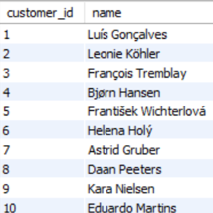
Objective Questions
Customers Who Haven’t Made Purchases In 3 Months

Slide 9
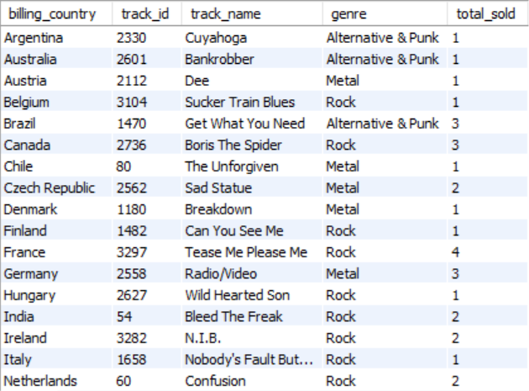
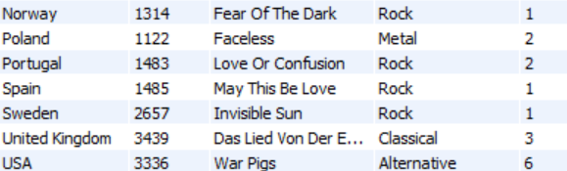
Insights & Recommendations
Top-Selling Tracks Around The World

Slide 10
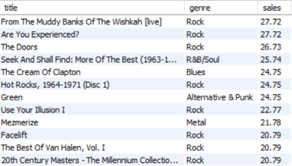
Insights & Recommendations
Upon analysis based on genre and sales, the three albums recommended for promotion are the bestselling non-Rock albums shown in the adjacent table:
1) Seek And Shall Find
2) The Cream Of Clapton
3) Green

Slide 11
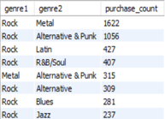
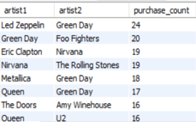
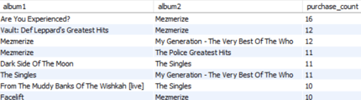
Insights & Recommendations
Co-Purchased Genres, Artists & Albums

Slide 12
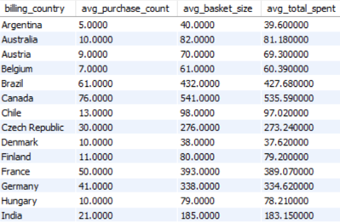
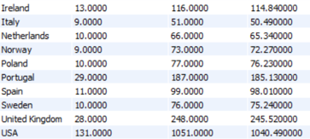
Insights & Recommendations
Variance Of Purchasing Behavior Across The World
Thus, we find greatest activity among the major European and North American nations. Italy is an exception to this pattern, while India also stands out for its relatively significant purchasing and for being the only Asian region represented here.

Slide 13
Insights & Recommendations
Purchasing Behaviour: New Customers v/s Old
Typically, long-term customers make purchases more frequently. This indicates their consistent engagement and satisfaction with the service or products. New customers might have a lower purchase frequency as they are still exploring the value and offerings of the service.
Long-term customers often have larger basket sizes as they tend to buy more products per transaction, possibly due to trust and satisfaction built over time. New customers might start with smaller basket sizes and get acquainted with the product offerings.

Slide 14
Insights & Recommendations
Purchasing Behaviour: New Customers v/s Old
3. Cumulatively, long-term customers generally spend more over time, reflecting their loyalty and continued patronage. The total spending amount for new customers is likely lower initially but can increase as they become more engaged.

Slide 15
Insights & Recommendations
  Incorporating promotional campaigns (discounts, events, email marketing) into customer acquisition, retention, and overall sales?
First, we gather data on the promotional activities (type of promotion, the duration, and the target audience). It is integrated with customer data/sales transactions/engagement metrics.
Compare the no. of new customers during the promotional period v/s a control period without promotions.

Slide 16
Insights & Recommendations
Incorporating promotional campaigns (discounts, events, email marketing) into customer acquisition, retention, and overall sales?
For customer retention, analyze repeat purchase behavior by comparing the frequency & recency of purchases during promotional campaigns (reveals whether customers acquired during promotions tend to remain active longer).
Overall sales impact measured by evaluating total revenue and average order value during the campaign periods relative to non-campaign periods.
Additionally, assessing the effectiveness of different types of promotions can provide deeper insights.

Slide 17
Insights & Recommendations
Identifying & handling customers who churn
Customers with infrequent purchases are more likely to churn.
Customers with lower total spending might not see enough value in the service to remain loyal. Conversely, high spenders might churn if they find a better value elsewhere.
Some regions might have higher churn rates due to local competition, economic factors, or cultural preferences. Analyzing regional churn patterns can provide insights into these factors.

Slide 18
Insights & Recommendations
Identifying & handling customers who churn
Customers who engage with the service are less likely to churn.
New customers are more likely to churn compared to long-term customers.
Customers who primarily purchase during promotions may churn when there are no discounts available. Customers who have niche preferences may churn if their preferred products or genres are no longer available or updated.

Slide 19
Conclusion
The Chinook record store, already notably successful in the Anglosphere, shows potential to make larger gains in this region as well as replicate its success elsewhere.
It can do so by encouraging the simultaneous purchase of music from genres/artists that have been shows to form lucrative pairings with other genres/artists.

Slide 20
Conclusion
2) Further, the data on the best-performing songs in each country opens up scope for deeper research into genre preferences internationally.
Chinook could utilize this information in promotional campaigns to initiate business in new regions geographically close to existing country-clients.

